Slide 1
PSHE PARENT INFORMATION UPDATE
Ten: Ten - Life to the Full
September 2024

Slide 2
Acronyms
EYFS – Early Years Foundation Stage (Nursery and Reception)
PSHE – Personal, Social, Health and economic Education
RSE – Relationships and Sex Education
RSHE - Relationships Sex and Health Education
DfE – Department for Education

Slide 3
Aims of the Presentation
This presentation will cover:
1. An update on PSHE and RSE
2. A reminder of what RSE is and why is it needed in a Catholic school?
3. An introduction to the new teaching programme for RSE – ‘Life to the Full’ produced by Ten:Ten Resources - and it’s objectives, structure and content.

Slide 4
Statutory Guidance
Further information about the statutory guidance set out by the DfE can be found by following the link below:
https://www.gov.uk/government/publications/relationships-education-relationships-and-sex-education-rse-and-health-education

Slide 5
RSE at St. Charles
RSE forms a part of the R.E., PSHE Programme, science, P.E. and computing curriculum.
Our key objective is developing the well-being of the child.
We believe parents are the prime educators of their children.
The school, church and family will work together; our role as a school is to support you and not to replace you.

Slide 6
What is RSE?
RSE is the life long learning about physical, moral and emotional development.
It is the understanding of the importance of marriage for family life, stable and loving relationships, respect, love and care.
It is also about the teaching of sex, sexuality and sexual health.

Slide 7
Right to Withdraw
Parents have the right to withdraw their children from elements of sex education that are not in line with the National Curriculum for Science, however we strongly recommend inclusion.
Parents may not withdraw their children from any aspects of Relationship and Health Education covered within the science curriculum.
Requests to withdraw your child from non-statutory sex education must be directed to Mr. Holt, in writing.

Slide 8
Special Educational Needs and Disabilities (SEND)
We will ensure that RSE & Health Education is accessible for all pupils including those with Special Education Needs &/or Disabilities (SEND).
We are aware that some pupils are more vulnerable, due to the nature of their SEND, and we will tailor content and teaching to their specific needs.

Slide 9

Ten:Ten Resources
‘Life to the Full’ Programme

Slide 10

Ten:Ten Resources
‘Life to the Full’ Programme

Slide 11
Who are Ten: Ten?
Ten:Ten Resources is a family-run, award-winning organisation that has been working in Catholic education for over 15 years, using story and drama to speak to hearts and minds.
Originally founded as a theatre-in-education company, Ten:Ten Resources has grown into a widely-used and highly-regarded educational and film company specialising in providing resources in Prayer, Liturgy and Relationship Education from a Catholic faith-based perspective.
Their name 'Ten: Ten' comes from the Scripture passage John 10:10:
"I have come that you may have life, life to the full.”

Slide 12
Ten:Ten Resources
Approved by the Diocese, the programme sets out ten principles for Catholic Relationships Education:
Our bodies are good
Through loving relationships we become close to the image and likeness of God
Catholic Relationships Sex and Health Education (RSHE) is about the whole person
Catholic RSHE should be taught in partnership with parents
Our deepest identity is as a child of God
Story can change hearts and minds
Catholic RSHE is an education in virtue
Catholic RSHE is an education in conscience
Relationship education is about striving for the common good
Prayer, Scripture and the Sacraments underpin the teaching

Slide 13
What is Life to the Full?
The Life to the Full programme includes:
Over 80 lesson plans for EYFS to Year 6
High-quality videos created by Ten:Ten specifically for UK-based Catholic primary schools
Parent Online Parent Portal for links to home

Slide 14
The Structure of ‘Life to the Full’
‘Life to the Full’ isn’t just a series of lesson plans for teachers to follow: they have created an entire platform of creative resources which we hope will engage, inform and inspire you, your child and their peers. This includes:
Interactive video content
Story-based activities
A wide range of teaching tools
Original worship music
An accompanying programme of classroom prayers
A ‘Parent Portal’ for parents to engage with the teaching and deepen the experience for their children.
This structure is based on ‘A Model Catholic RSE Curriculum’ by the Catholic Education Service, which was highlighted as a work of good practice by the Department for Education.

Slide 15
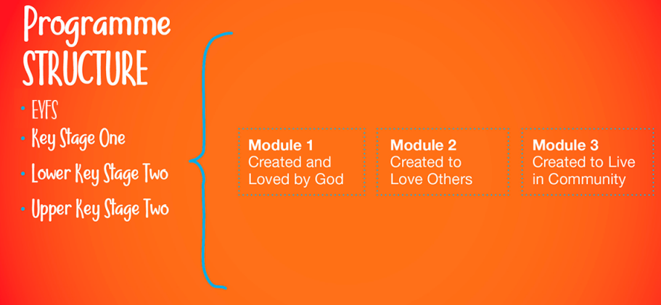
The Structure of ‘Life to the Full’
Each learning stage covers the same 3 Modules, which take their names from the three themes of the CES Model Curriculum:

Slide 16
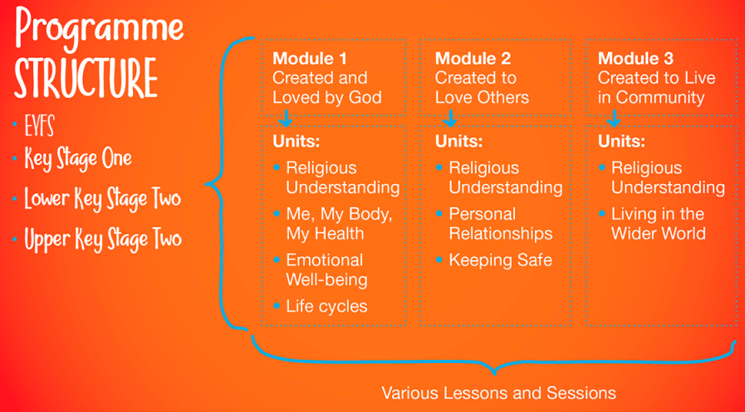
The Structure of ‘Life to the Full’
Each Module also covers the same Unit topics across each Learning Stage:

Slide 17
Online Parent Portal
As part of Life to the Full, Ten:Ten have created an Online Parent Portal. This section of the website is available to all parents, so that you can access and see the resources being used in each year group.
The Online Parent Portal provides a summary of each lesson, links to specific content and suggestions for further engagement at home.

Slide 18
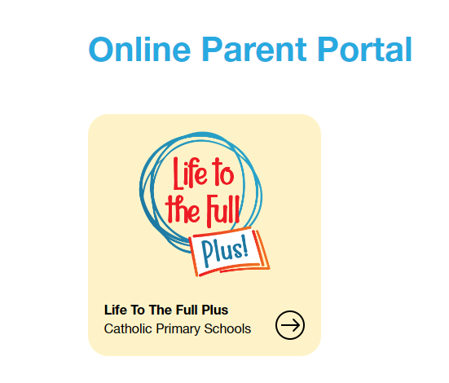
Access to the Parent Portal
You can access the Parent Portal using the following:
www.tentenresources.co.uk/parent-portal
Username - stchb
Password - tenten

Slide 19

What it Looks Like

Slide 20

This is a screen shot, the videos are available on the Parent Portal.

Slide 21
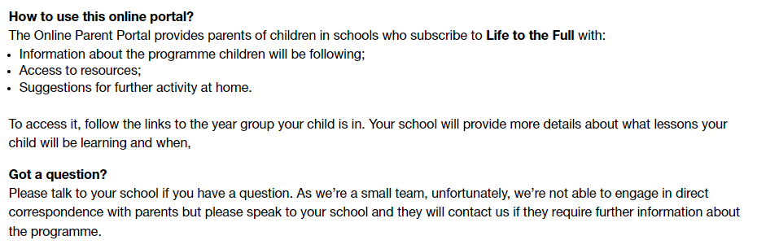
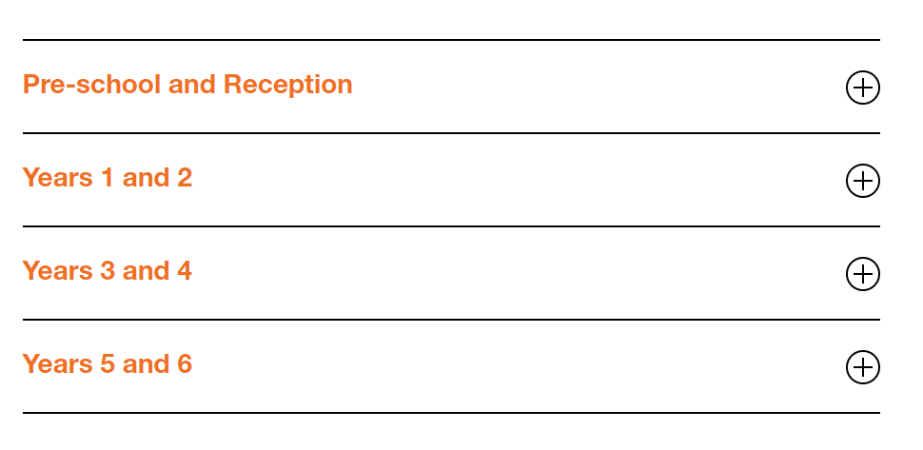
This is a screen shot, the videos are available on the Parent Portal.

Slide 22
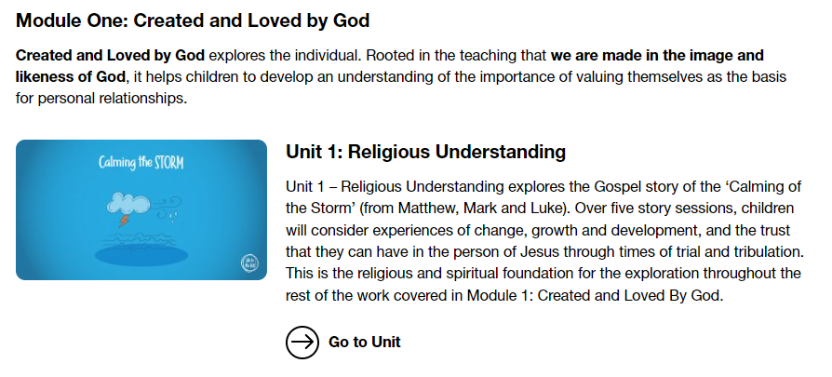
Within each of the year group areas you will find links to the individual module that will be taught. The PSHE curriculum map for each year group shows which module will be covered in that year.
This is a screen shot, the videos are available on the Parent Portal.

Slide 23
Curriculum Maps for each year group are available in the PSHE section of the school website.

Slide 24
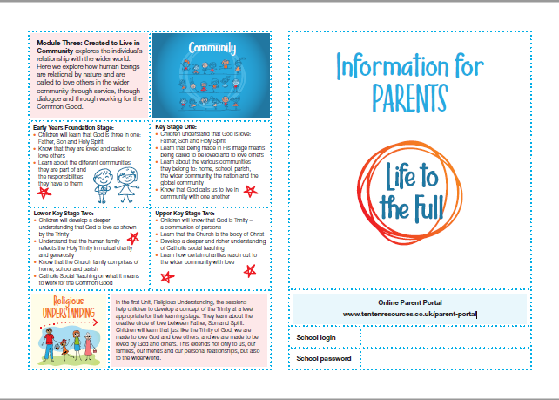
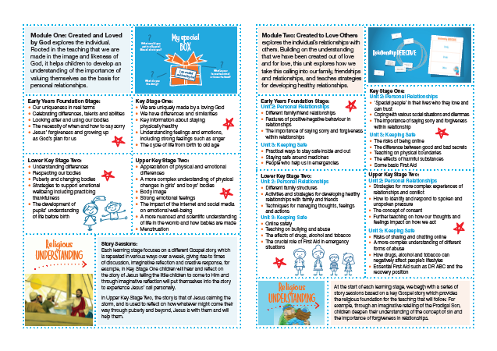
This information leaflet is available to download from the site which provides and overview of what is covered in each year group.

Slide 25
Thank you for reading this presentation.
If you have any queries about the content of the curriculum that your child will be taught, please discuss this with their class teacher.
In addition to this, if you have any other feedback then please contact Mrs. Brown (RE/RSE Lead) through the school office.

